Slide 1

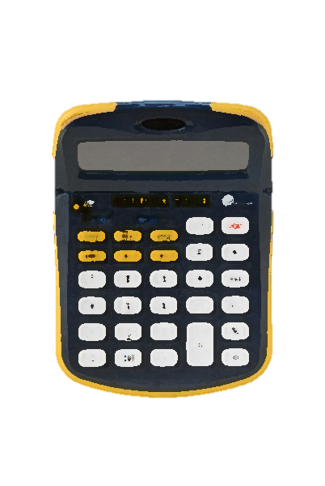
GT GPA Calculator
Written by: Joon Ki Hong

Slide 2
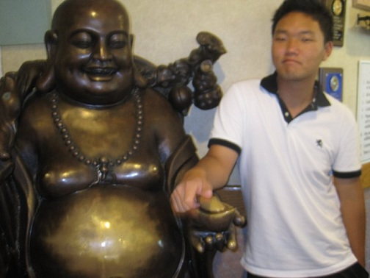
About Myself
Full Name: Joon Ki Hong
Ethnicity: Korean
Born: in Seoul, South Korea
Residence: Fort Lee, NJ
Major: 1st Year CS
Hobbies:
Games
Reading
Tennis
Basketball
Table Tennis
Frisbee

Slide 3

My Program
Simple program that creates/loads user data and calculates your actual GPA and GT GPA using prompts.
No hassle of re-calculating your GPA
Update your GPA through your semester
Save Data to keep track of your progress
Load previously saved data to re-check or update
Created to remove the hassle of checking how to calculate your GPA and recalculating each time.
Came up with the idea knowing that some students actually don’t know how to calculate their GPA’s

Slide 4
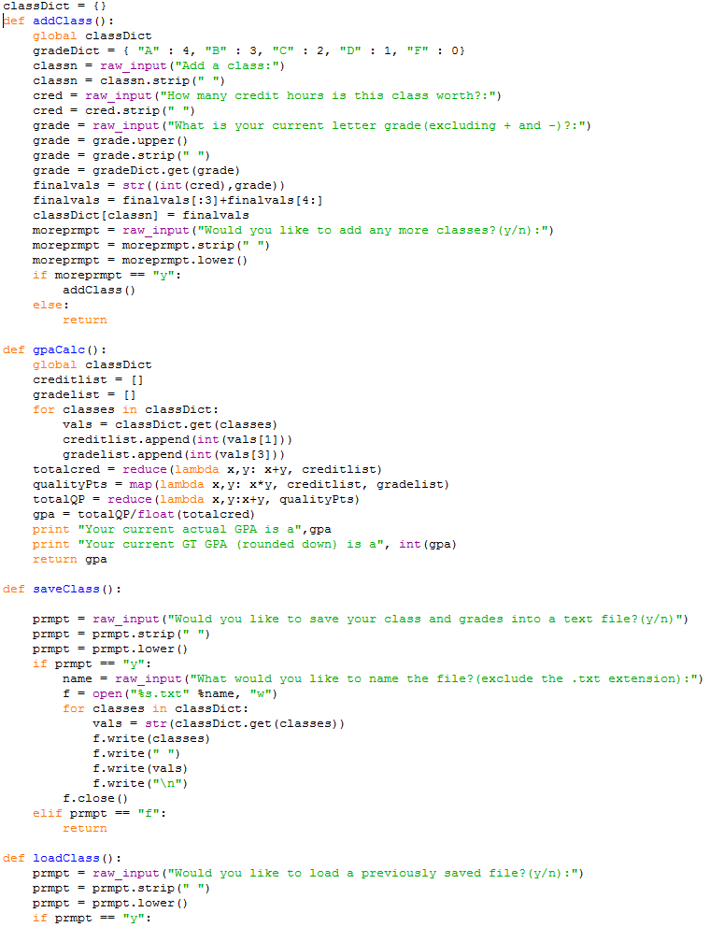
Code
Use of Dictionaries to translate letter grades to integers
gradeDict = { "A" : 4, "B" : 3, "C" : 2, "D" : 1, "F" : 0}
classDict = {} – stores {class: (credit,grade)}
Use of the map and reduce functions to calculate numbers
totalcred = reduce(lambda x,y: x+y, creditlist)
qualityPts = map(lambda x,y: x*y, creditlist, gradelist)
totalQP = reduce(lambda x,y:x+y, qualityPts)
Use of File inputs and outputs
File writing/reading
Indexing / String formatting / Manipulation
Multiple functions
saveClass
loadClass
gpaCalc
addClass
updateClass

Slide 5
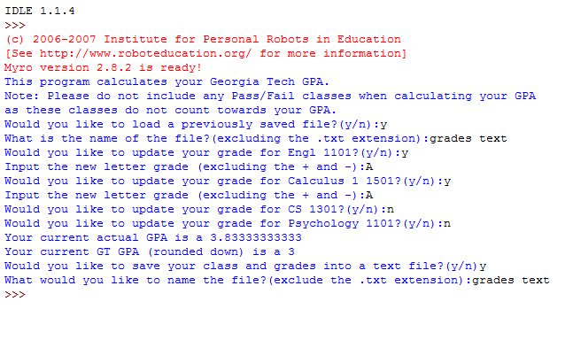
Load/Update/Save
Example of the module running
Loading a file
Updating Grades
Recalculating GPA
Saving File

Slide 6
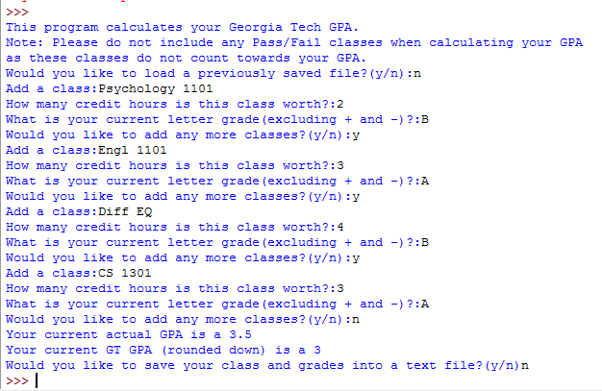
Add Classes/Calculate/Save
This is an example output of the interpreter showing how one can add classes, # of credit hours, and current grade

Slide 7
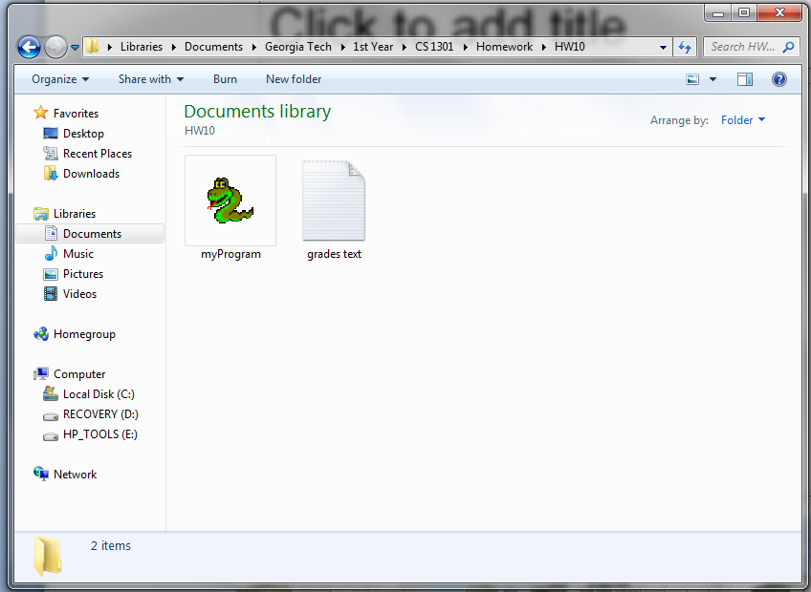

Saved output
The saved file is located in the same directory as the python file.

